Slide 1

SHRI VISHNU ENGINEERING COLLEGE FOR WOMEN
(AUTONOMOUS), BHIMAVARAM – 534 202
DEPARTMENT OF INFORMATION TECHNOLOGY
Operating Systems
Course Instructor
Dr. C.Shanmuganathan
Date : 30-07-2020

Slide 2
COURSE OBJECTIVES
Study the basic principles and functionality of operating systems
Understand the concepts of CPU scheduling, concurrent processes, deadlock
Identify the significance of file systems, virtual memory
Understand disk scheduling, memory management, and device management

Slide 3
SYLLABUS OVERVIEW
UNIT-I Introduction - Concept of Operating Systems, Operating Systems Objectives and Functions, Generations of Operating systems, Types of Operating Systems, OS Services, System Calls, Structure of an OS - Layered, Protection and Security, Case study on UNIX and WINDOWS Operating System.
UNIT-II Process Management – Process concept- process scheduling, operations, Inter process communication. Multi Thread programming models. Process scheduling criteria and algorithms (FCFS, SJF, Priority, RR, Multilevel queue Scheduling), and their evaluation.

Slide 4
SYLLABUS OVERVIEW
UNIT-III Process synchronization, the critical- section problem, Peterson’s Solution, synchronization Hardware, semaphores, classic problems of synchronization, monitors, Producer Consumer problem, Readers & Writers Problem, Dining Philosopher Problem.
UNIT-IV Deadlocks: Definition, Necessary and sufficient conditions for Deadlock, Deadlock Prevention, Deadlock Avoidance: Banker’s algorithm, Deadlock detection and Recovery.

Slide 5
SYLLABUS OVERVIEW
UNIT-V Memory Management: Swapping, contiguous memory allocation, paging, structure of the page table, segmentation, Virtual memory, demand paging, page-Replacement, algorithms, Allocation of Frames, Thrashing.
UNIT-VI File Management: Concept of File, Access methods, File types, File operation, Directory structure, File System structure, Allocation methods (contiguous, linked, indexed), Free-space management (bit vector, linked list, grouping), directory implementation (linear list, hash table), efficiency and performance.
Disk Management: Disk structure, Disk scheduling - FCFS, SSTF, SCAN, C-SCAN, Disk reliability, Disk formatting, Boot-block, Bad blocks

Slide 6
SYLLABUS OVERVIEW
TEXT BOOKS:
Operating System Concepts- Abraham Silberchatz, Peter B. Galvin, Greg Gagne 9th Edition, John Wiley publishers, 2012.
Operating Systems’ – Internal and Design Principles, Stallings, Sixth Edition, Pearson education, 2005.

Slide 7
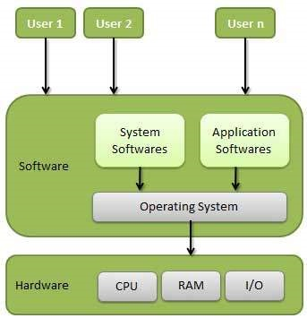
INTRODUCTION TO OS
Definition
An operating system is a program that manages a computer’s hardware. It also provides a basis for application programs and acts as an intermediary between the computer user and the computer hardware.

Slide 8
OBJECTIVES OF OS
To make the computer system convenient to use in an efficient manner.
To hide the details of the hardware resources from the users.
To provide users a convenient interface to use the computer system.
To act as an intermediary between the hardware and its users, making it easier for the users to access and use other resources.
To manage the resources of a computer system.
To keep track of who is using which resource, granting resource requests, and mediating conflicting requests from different programs and users.
To provide efficient and fair sharing of resources among users and programs.

Slide 9
FUNCTIONS OF OS
Memory Management
Processor Management
Device Management
File Management
Security
Control over system performance
Job accounting
Error detecting
Coordination between other software and users

Slide 10
FUNCTIONS OF OS – MEMORY MANAGEMENT
Keeps tracks of primary memory,
i.e., what part in use by whom,
what part are not in use.
In multiprogramming, the OS decides which process will get memory when and how much.
Allocates the memory when a process requests it.
De-allocates the memory when a process no longer needs it or has been terminated.

Slide 11
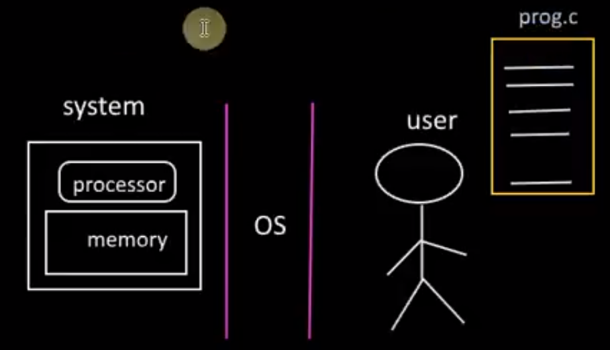
FUNCTIONS OF OS – MEMORY MANAGEMENT

Slide 12
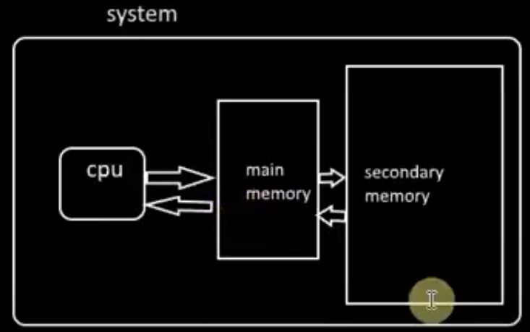
FUNCTIONS OF OS – MEMORY MANAGEMENT

Slide 13
FUNCTIONS OF OS – PROCESS MANAGEMENT
The OS must allocate resources to processes.
Protect the resources of each process from other processes.
Enable synchronization among processes.
Keeps tracks of processor and state of the process.
De-allocates processor when a process is no longer required.
The program responsible for this task is known as traffic controller.

Slide 14
FUNCTIONS OF OS – DEVICE MANAGEMENT
Keeps tracks of all devices.
Decides which process gets the device when and for how much time.
Allocates the device in the efficient way.
De-allocates devices.
Program responsible for this task is known as the I/O controller.

Slide 15
FUNCTIONS OF OS – FILE MANAGEMENT
Keeps track of information, location, uses, status etc.
The collective facilities are often known as file system.
Decides who gets the resources.
Allocates the resources.
De-allocates the resources.

Slide 16
FUNCTIONS OF OS –OTHERS
Security − By means of password and similar other techniques, it prevents unauthorized access to programs and data.
Control over system performance − Recording delays between request for a service and response from the system.
Job accounting − Keeping track of time and resources used by various jobs and users.

Slide 17
FUNCTIONS OF OS –OTHERS
Error detecting− Production of dumps, traces, error messages, and other debugging and error detecting aids.
Coordination between other software and users − Coordination and assignment of compilers, interpreters, assemblers and other software to the various users of the computer systems.

Slide 18
GENERATIONS OF OS
1940s: Zeroth generation (No Operating System)
1950s: First generation
Early 1960s: Second generation
1960 – 1970: Third generation
1970 – Present: Fourth generation

Slide 19
GENERATIONS OF OS
1940s: Zeroth generation
Early computing systems had no operating system.
Users had complete access to the machine language.
They hand-coded all instructions.

Slide 20
GENERATIONS OF OS
1950s: First generation
The operating systems of the 1950s were designed to smooth the transition between jobs.
Batch processing system was introduced.
This was the beginning of batch processing systems in which jobs were gathered in groups or batches.
Once a job was running, it had total control of the machine.
As each job terminated (either normally or abnormally), control was returned to the operating system that "cleaned up after the job" and read in and initiated the next job.

Slide 21
GENERATIONS OF OS
1960s: Second generation
The second generation of operating systems was characterized by the development of shared systems with multiprogramming and beginnings of multiprocessing.
In multiprogramming systems several user programs are in main memory at once and the processor is switched rapidly between the jobs.
In multiprocessing systems, several processors are used on a single computer system to increase the processing power of the machine.

Slide 22
GENERATIONS OF OS
1960 - 1970: Third generation
The third generation of operating systems effectively began with the introduction of the IBM system/360 family of computers in 1964.
Third generation computers were designed to be general-purpose systems.
Third generation operating systems were multimode systems.
Some of them simultaneously supported batch processing, time sharing, real-time processing, and multiprocessing.

Slide 23
GENERATIONS OF OS
1970 - Present: Fourth generation
Fourth generation systems are the current state of the art.
More flexible hardware (firmware)
Distributed processing and networked systems introduced.
Evolution of high-speed communications
Evolution of personal computers
Demand for Internet capability
Increased networking
Increased tighter security demands to protect hardware and software.

Slide 24
TYPES OF OPERATING SYSTEM
Batch Processing System
Multitasking System
Multiprocessor System
Real Time System
Distributed System

Slide 25
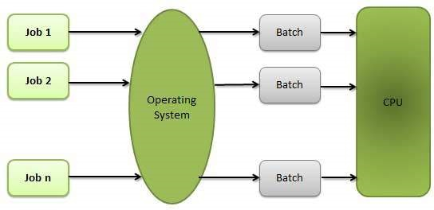
TYPES OF OS – BATCH PROCESSING SYSTEM
Batch processing is a technique in which an Operating System collects the programs and data together in a batch before processing starts

Slide 26
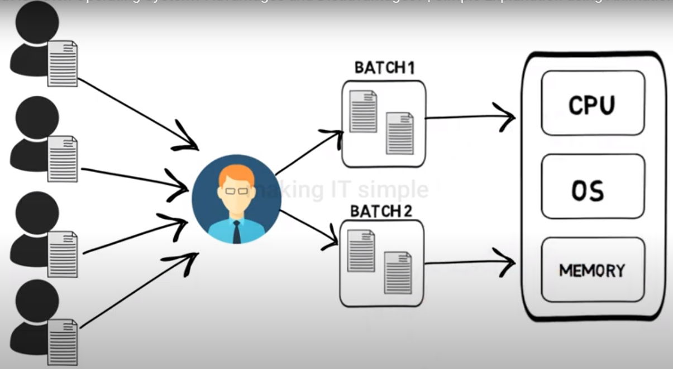
TYPES OF OS – BATCH PROCESSING SYSTEM
This type of operating system does not interact with the computer directly.
There is an operator which takes similar jobs having same requirement and group them into batches.

Slide 27
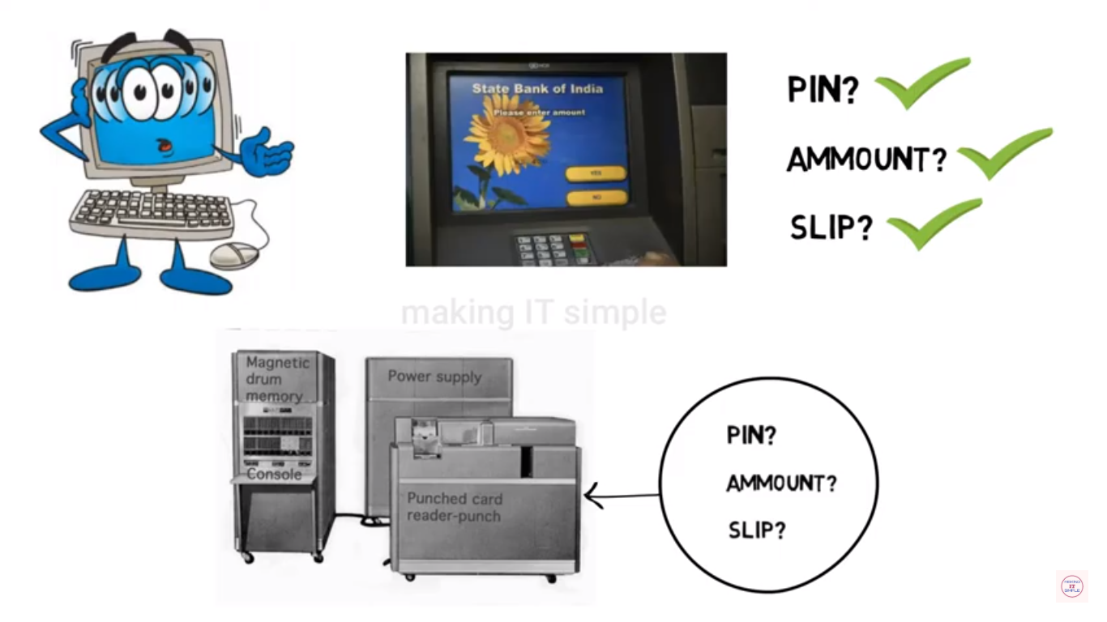
TYPES OF OS – BATCH PROCESSING SYSTEM
Example 1

Slide 28
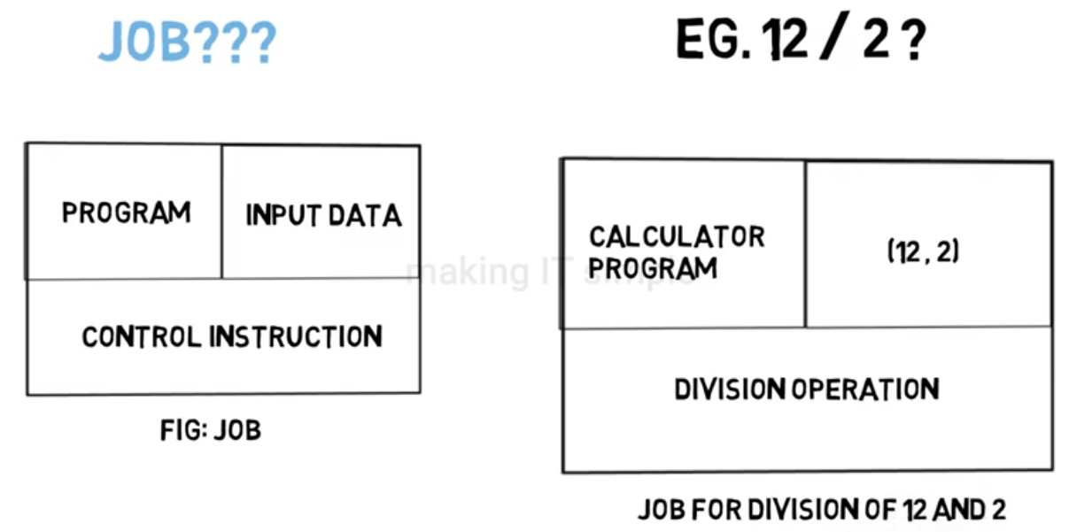
TYPES OF OS – BATCH PROCESSING SYSTEM
Example 2

Slide 29
TYPES OF OPERATING SYSTEM
Advantages
No interaction between user and computer.
No mechanism to prioritize the processes.
Disadvantages
Difficult to debug program.
A job could enter an infinite loop.
Due to lack of protection scheme, one batch job can affect pending jobs.

Slide 30
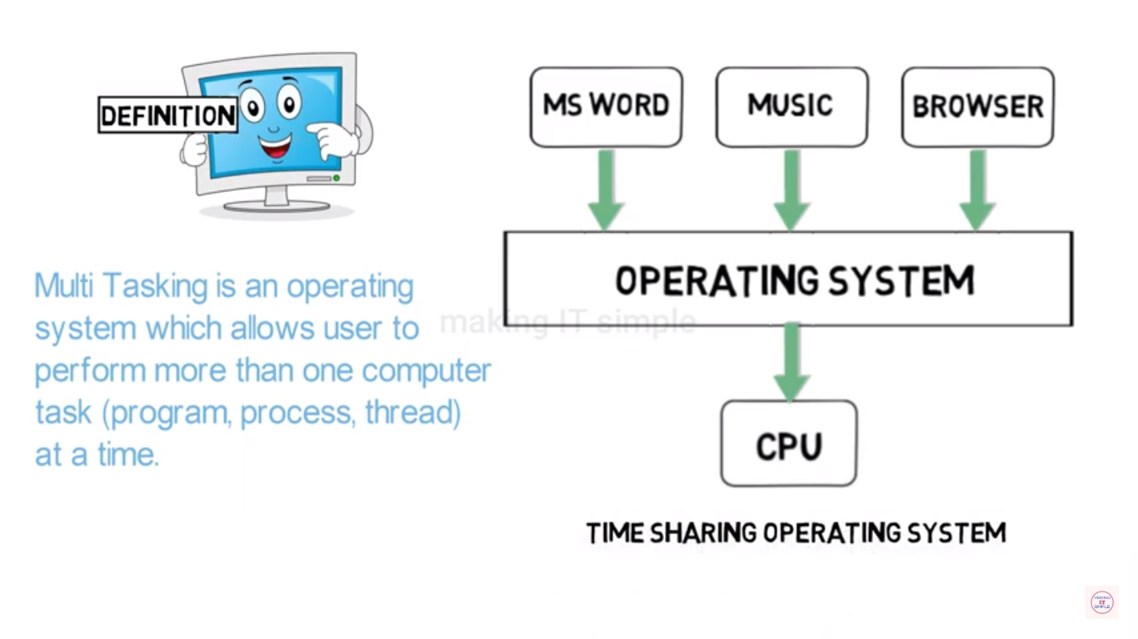
TYPES OF OS – TIME SHARING
A time-shared operating system uses the concept of CPU scheduling

Slide 31
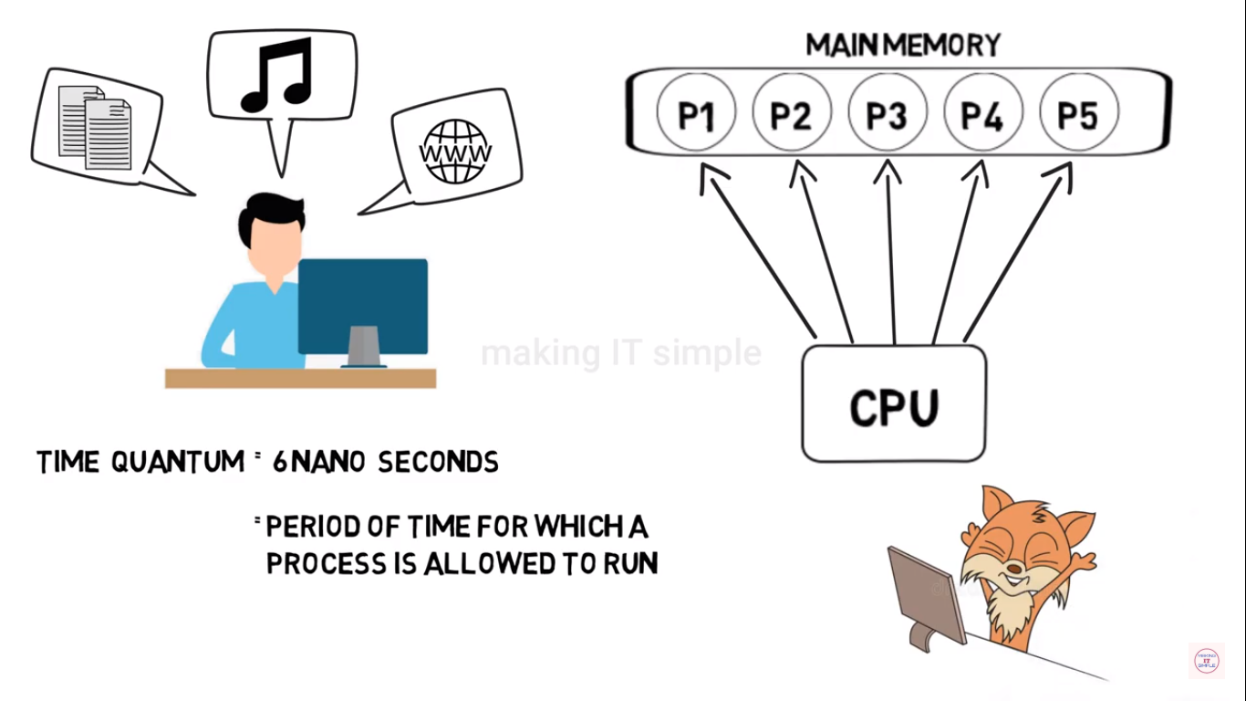
TYPES OF OS – TIME SHARING

Slide 32
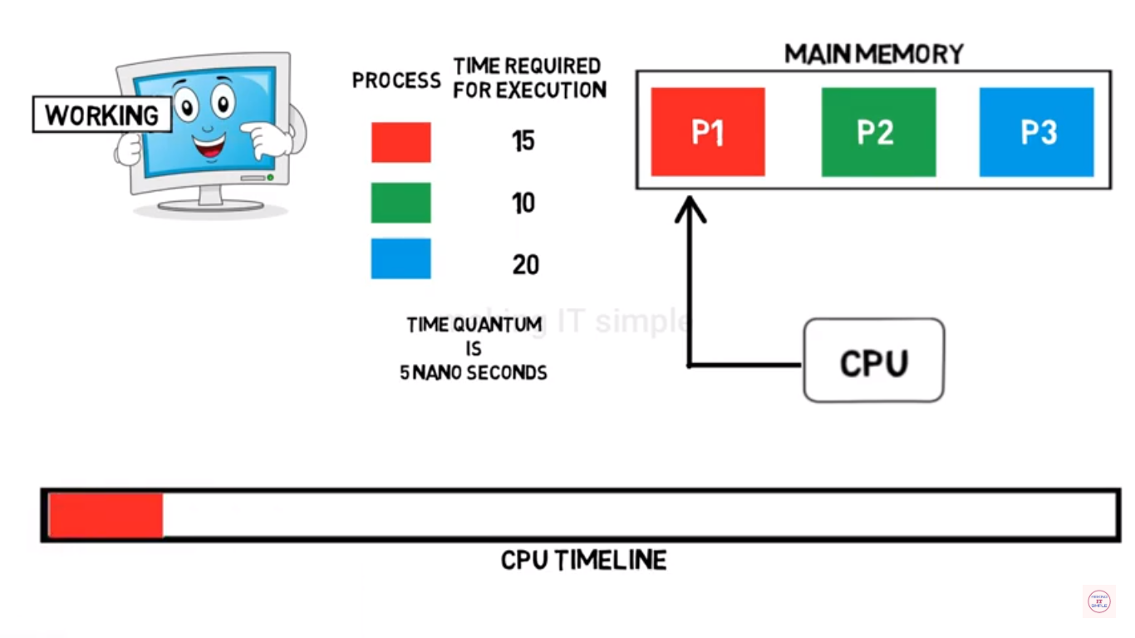
TYPES OF OPERATING SYSTEM
Batch Processing System
Multitasking System
Multiprogramming
Real Time System
Distributed System

Slide 33
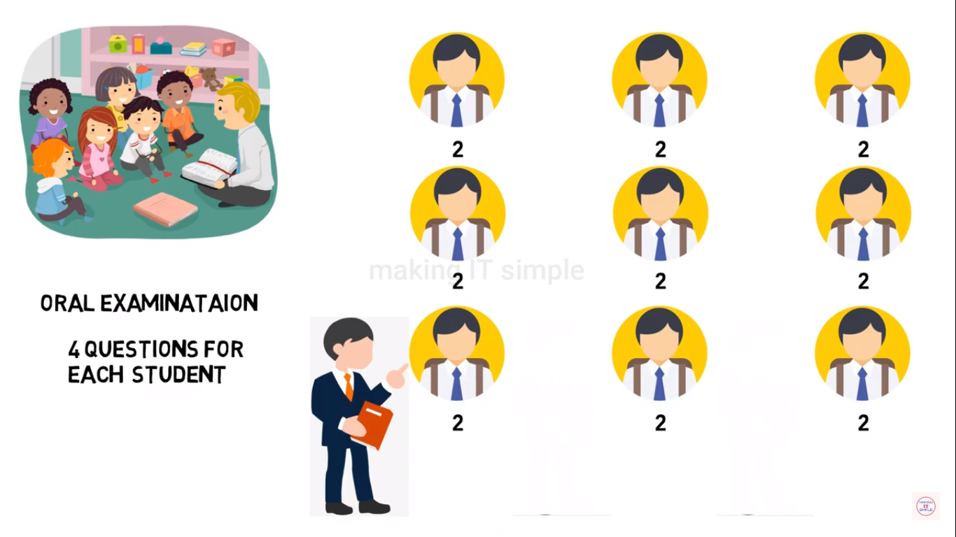
TYPES OF OS – TIME SHARING

Slide 34
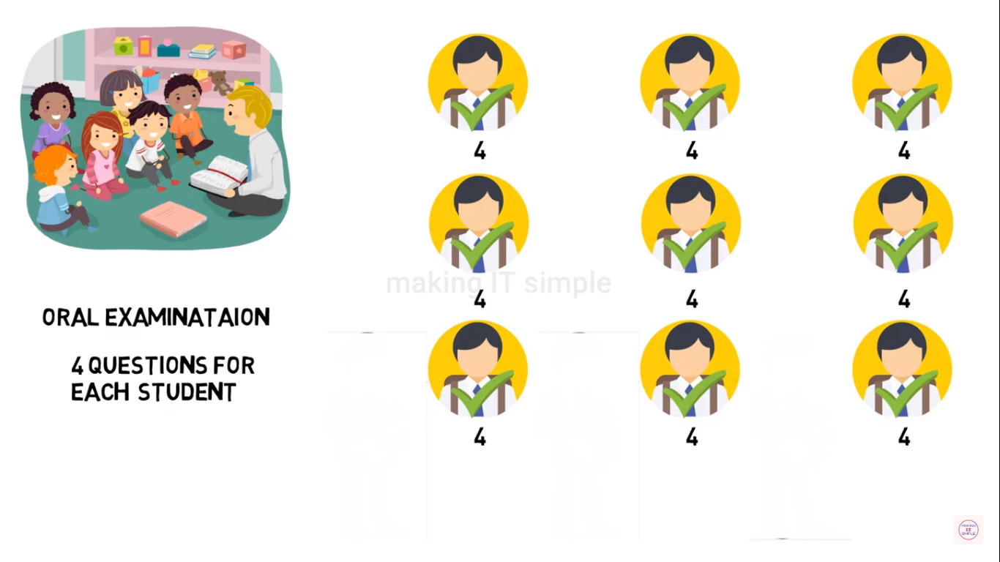
TYPES OF OS – TIME SHARING

Slide 35
TYPES OF OS – TIME SHARING
Advantages
High and efficient CPU utilization.
User feels that many programs are allotted CPU almost simultaneously.
Disadvantages
CPU scheduling is required.
To accommodate many jobs in memory, memory management is required.

Slide 36
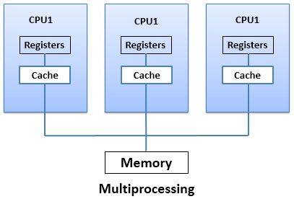
TYPES OF OS – MULTIPROCESSOR SYSTEM
A Multiprocessor system consists of several processors that share a common physical memory.
Multiprocessor system provides higher computing power and speed.
In multiprocessor system all processors operate under single operating system.

Slide 37
TYPES OF OS – MULTIPROCESSOR SYSTEM
Advantages
Enhanced performance
Execution of several tasks by different processors concurrently, increases the system's throughput without speeding up the execution of a single task.
System divides task into many subtasks and then these subtasks can be executed in parallel in different processors.
Thereby speeding up the execution of single tasks.

Slide 38
TYPES OF OS – REAL TIME SYSTEM
Real-time systems are usually dedicated, embedded systems.
An operating system does the following activities related to real-time system activity.
Operating Systems typically read from and react to sensor data.
The Operating system must guarantee response to events within fixed periods of time to ensure correct performance.
It is defined as an operating system known to give maximum time for each of the critical operations that it performs.

Slide 39
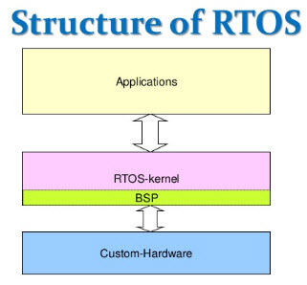
TYPES OF OS – REAL TIME SYSTEM

Slide 40
TYPES OF OS – DISTRIBUTED SYSTEM
The OS distributes computation logics among several physical processors.
The processors do not share memory or a clock. Instead, each processor has its own local memory.
The OS manages the communications between the processors.
They communicate with each other through various communication lines.

Slide 41
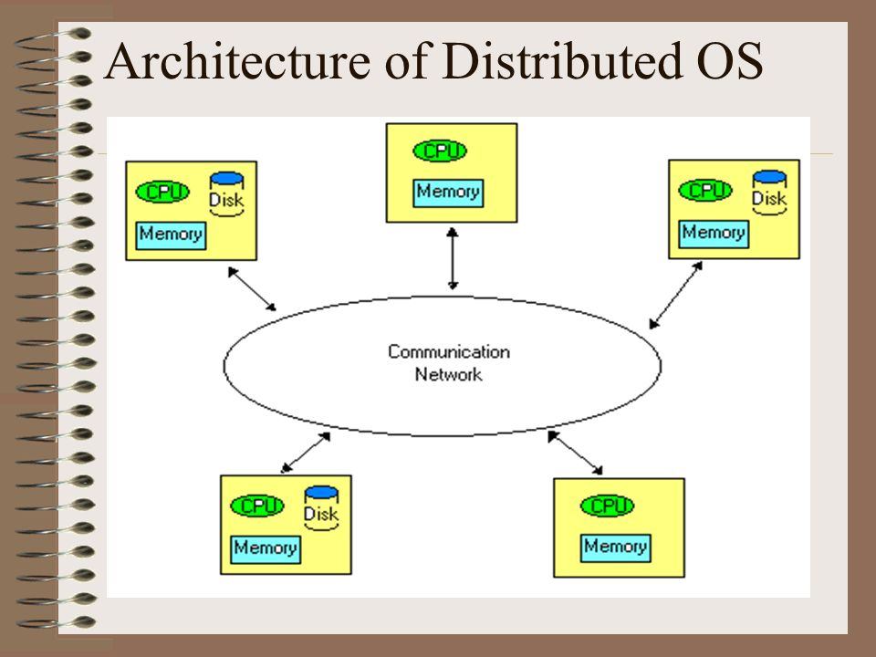
TYPES OF OS – DISTRIBUTED SYSTEM

Slide 42
TYPES OF OS – DISTRIBUTED SYSTEM
Advantages Distributed Operating System
As there are multiple systems involved, user at one site can utilize the resources of systems at other sites for resource-intensive tasks.
Fast processing.
Less load on the Host Machine.

Slide 43
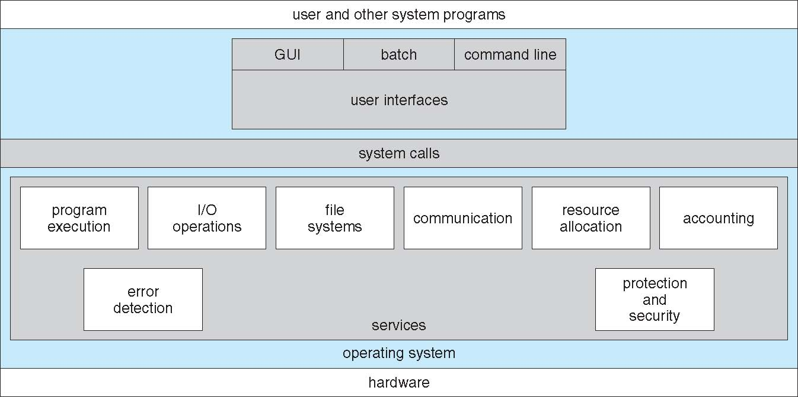
OPERATING SYSTEM SERVICES
An Operating System provides services to both the users and to the programs.
Operating systems provide an environment for execution of programs and services to programs and users.

Slide 44
OPERATING SYSTEM SERVICES
User Interface
Program Execution
File System Manipulation
I/O Operations
Communication System
Resource Allocation
Error Detection
Accounting
Protection and Security

Slide 45
OPERATING SYSTEM SERVICES
User interface - Almost all operating systems have a user interface (UI).
Command-Line (CLI),
Graphics User Interface (GUI),
Batch
Program execution - The system must be able to load a program into memory and to run that program, end execution, either normally or abnormally (indicating error)
I/O operations - A running program may require I/O, which may involve a file or an I/O device.
File-system manipulation - Programs need to read and write files and directories, create and delete them, search them, list file Information, permission management.

Slide 46
OPERATING SYSTEM SERVICES
Communications – Processes may exchange information, on the same computer or between computers over a network
Communications may be via shared memory or through message passing (packets moved by the OS)
Error detection – OS needs to be constantly aware of possible errors
May occur in the CPU and memory hardware, in I/O devices, in user program
For each type of error, OS should take the appropriate action to ensure correct and consistent computing.
Debugging facilities can greatly enhance the user’s and programmer’s abilities to efficiently use the system.

Slide 47
OPERATING SYSTEM SERVICES
Resource allocation - When multiple users or multiple jobs running concurrently, resources must be allocated to each of them
Many types of resources - Some (such as CPU cycles, main memory, and file storage) may have special allocation code, others (such as I/O devices) may have general request and release code
Accounting - To keep track of which users use how much and what kinds of computer resources

Slide 48
OPERATING SYSTEM SERVICES
Protection and security - The owners of information stored in a multiuser or networked computer system may want to control use of that information, concurrent processes should not interfere with each other.
Protection involves ensuring that all access to system resources is controlled
Security of the system from outsiders requires user authentication, extends to defending external I/O devices from invalid access attempts

Slide 49
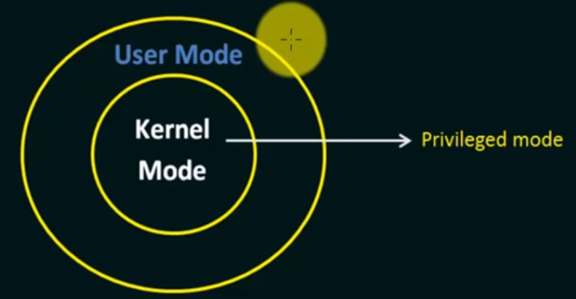
SYSTEM CALLS
A system call is the programming interface in which a computer program requests a service from the kernel of the operating system.

Slide 50
SYSTEM CALLS
Programming interface to the services provided by the OS
Typically written in a high-level language (C or C++)
Mostly accessed by programs via a high-level Application Programming Interface (API) rather than direct system call use
Three most common APIs are
Win32 API for Windows,
POSIX API for all versions of UNIX, Linux, and Mac OS X, and
Java API for the Java virtual machine (JVM)

Slide 51
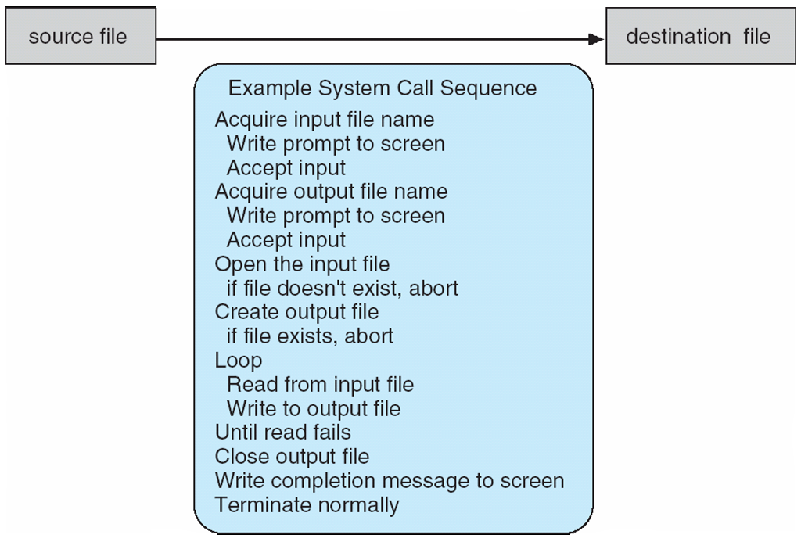
EXAMPLE - SYSTEM CALL
System call sequence to copy the contents of one file to another file

Slide 52
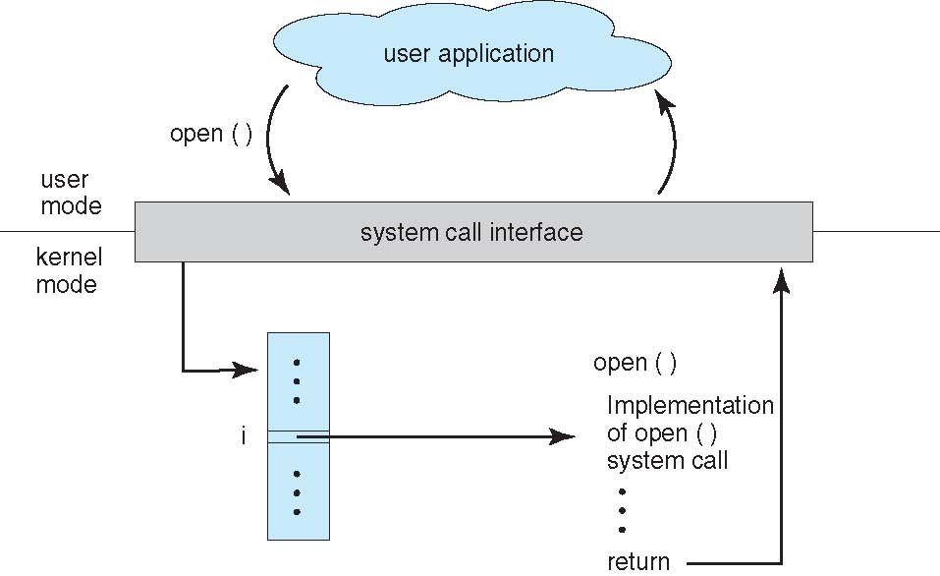
SYSTEM CALLS

Slide 53
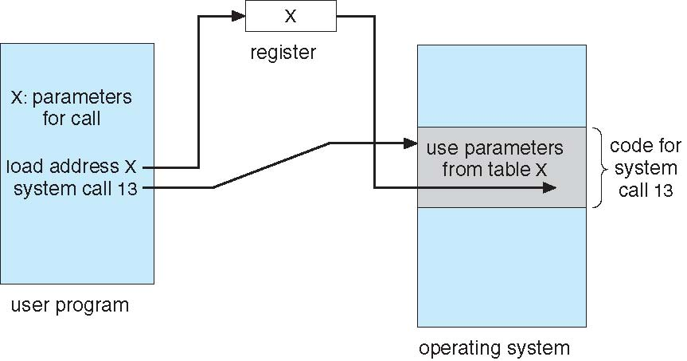
SYSTEM CALLS

Slide 54
TYPES OF SYSTEM CALLS
Process control
create process, terminate process
end, abort
load, execute
get process attributes, set process attributes
wait for time
wait event, signal event
allocate and free memory
Dump memory if error
Debugger for determining bugs, single step execution
Locks for managing access to shared data between processes

Slide 55
TYPES OF SYSTEM CALLS
File management
create file, delete file
open, close file
read, write, reposition
get and set file attributes
Device management
request device, release device
read, write, reposition
get device attributes, set device attributes
logically attach or detach devices

Slide 56
TYPES OF SYSTEM CALLS
Information maintenance
get time or date, set time or date
get system data, set system data
get and set process, file, or device attributes
Communications
create, delete communication connection
send, receive messages if message passing model to host name or process name
From client to server
Shared-memory model create and gain access to memory regions
transfer status information
attach and detach remote devices

Slide 57
TYPES OF SYSTEM CALLS
Protection
Control access to resources
Get and set permissions
Allow and deny user access

Slide 58
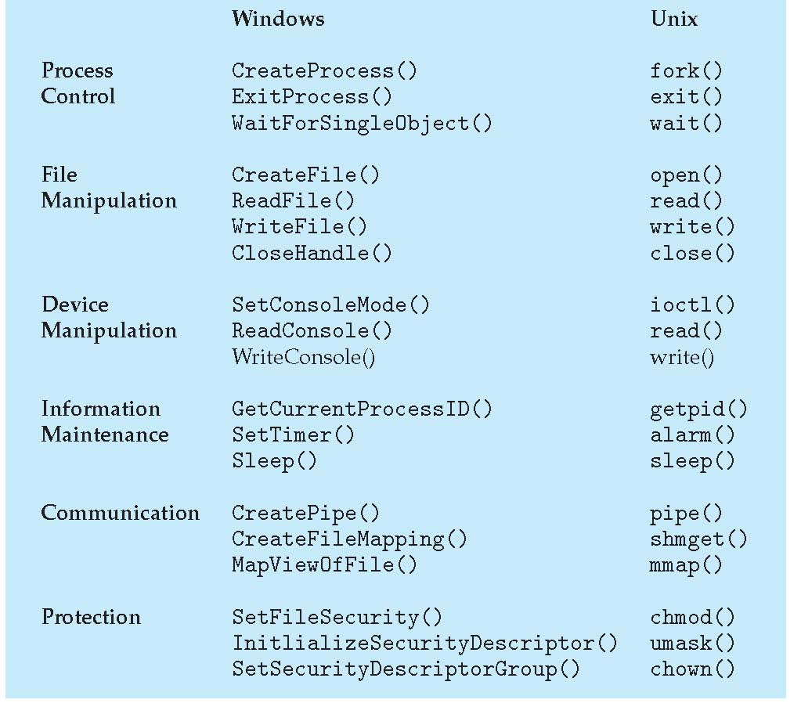
TYPES OF SYSTEM CALLS

Slide 59
STRUCTURE OF OS
The structure of the OS depends on how the various common components of the operating system are interconnected and melded into the kernel.
Types
Simple Structure
Layered Structure
Micro Kernel
Modular structure / Approach

Slide 60
SIMPLE STRUCTURE OF OS
MS-DOS
Notes:
Many operating systems do not have well-defined structures.
Figure shows the MS-DOS os structure
Such operating systems do not have well defined structure and are small, simple and limited systems.
The interfaces and levels of functionality are not well separated.
MS-DOS is an example of such operating system.
In MS-DOS application programs are able to access the basic I/O routines.
These types of operating system cause the entire system to crash if one of the user programs fails.

Slide 61
LAYERED STRUCTURE
Notes:
This is another approach called Layered structure.
An OS can be broken into pieces and retain much more control on system.
In this structure the OS is broken into number of layers (levels).
The bottom layer (layer 0) is the hardware and the topmost layer (layer N) is the user interface.
These layers are so designed that each layer uses the functions of the lower level layers only.
This simplifies the debugging process as if lower level layers are debugged and an error occurs during debugging then the error must be on that layer only as the lower level layers have already been debugged.
The main disadvantage of this structure is that at each layer, the data needs to be modified and passed on which adds overhead to the system.
Moreover careful planning of the layers is necessary as a layer can use only lower level layers.
UNIX is an example of this structure.

Slide 62
LAYERED STRUCTURE OF OS
Unix

Slide 63

THANK YOU
QUESTIONS PLEASE?

